Slide 1
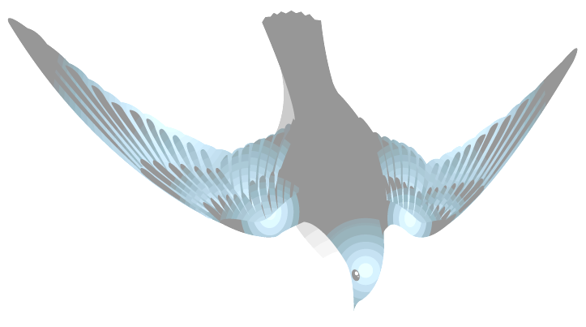

The Gamma Ray Burst Explorer
What is Swift (Marg Chester, Swift Ops Lead Scientist)
What are GRBs (Sally Hunsberger, Swift UVOT Scientist)
Penn State’s Role (Sally Hunsberger)
Tour of X-ray Telescope Lab and Future Mission Operations Center

Slide 2
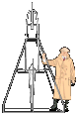





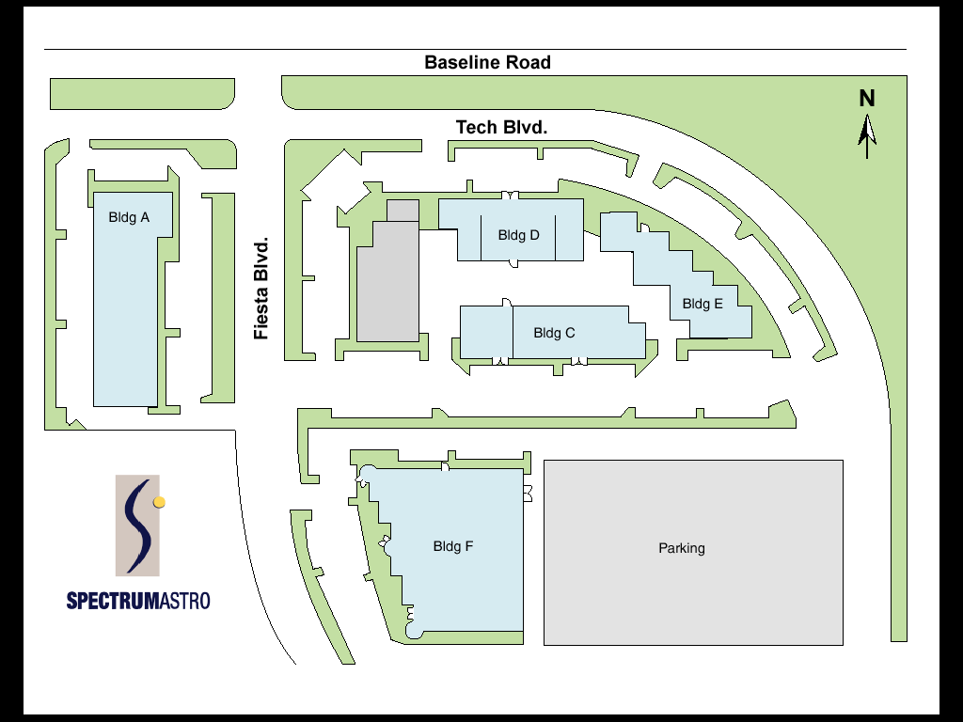





The Swift MIDEX
Prime Institution: GSFC (Neil Gehrels, PI)
Lead University Partner: Penn State (PSU)
Countries Involved: USA, Italy, UK
Spacecraft Partner: Spectrum Astro
Mission Operations Partner: Omitron

Slide 3
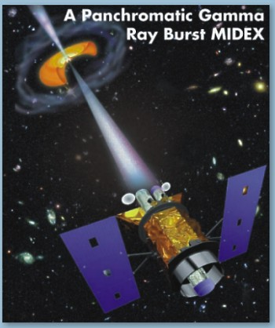
Swift Overview
Objectives
Study 100s of GRBs during mission
Determine origin of GRBs
Explore environment near GRBs
Use GRBs to probe the Universe
Perform all-sky hard X-ray survey
Rapidly re-pointing spacecraft
~ 1 minute automated response
Quick response to Targets of Opportunity
Data distributed immediately to astronomical community
Burst alerts in seconds
Follow-up observations in a day

Slide 4
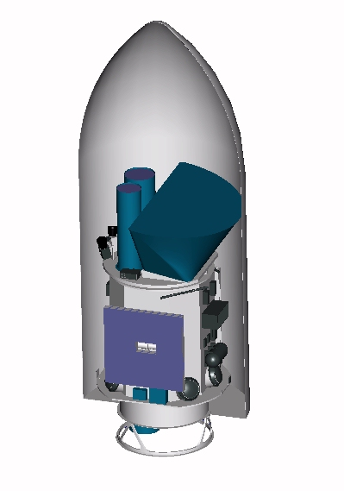
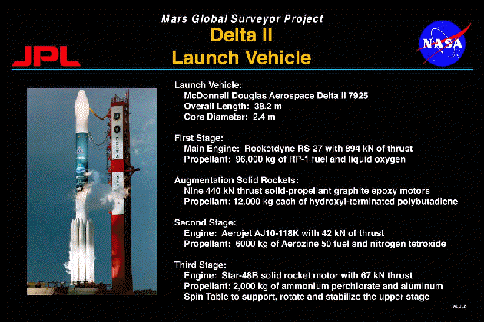
Spacecraft & Launcher
Launch date 2003
Spacecraft by Spectrum Astro
Launcher is Delta II (7320)
Low Earth Orbit: 600 km
Inclination ~20 degrees
Three-year mission operation life
Orbit stable for 5+ years without propulsion
Peak slew rate 50 degrees in < 50 s
Arrive within 1 arc-minute of target
Autonomous operations and pointing

Slide 5
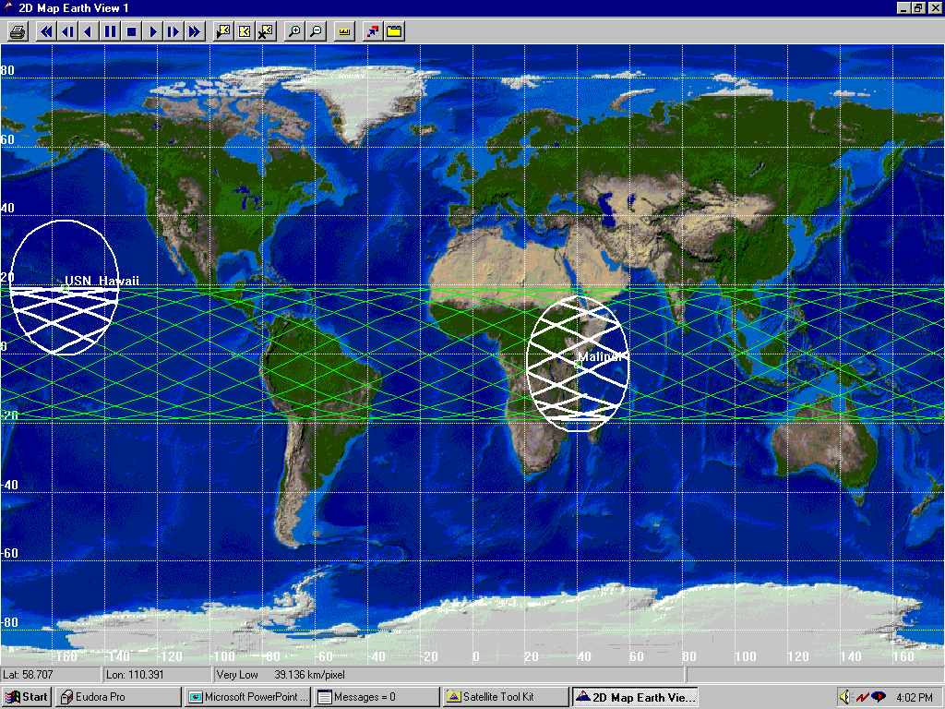
SWIFT Ground Track

Slide 6
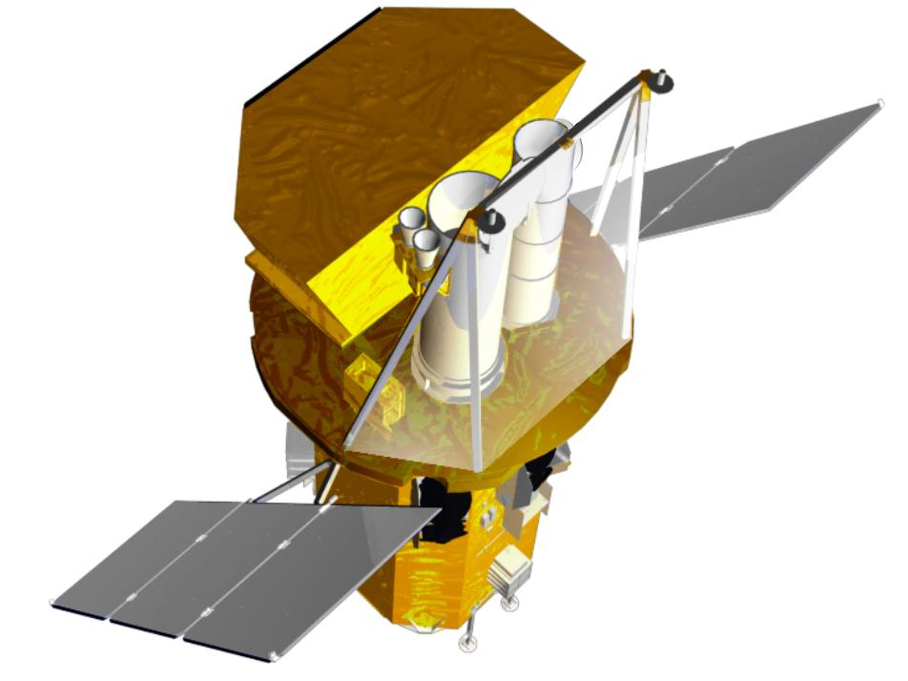
Swift Instruments
Burst Alert Telescope (BAT)
CZT detectors & coded aperture
Most sensitive gamma-ray imager ever
X-Ray Telescope (XRT)
Arcsecond GRB positions
CCD spectroscopy
Jet-X mirrors, XMM Detectors
UV/Optical Telescope (UVOT)
Sub-arcsecond imaging; Finding chart
Grism spectroscopy
24th mag sensitivity (1000 sec)
Copy of XMM OM
UVOT
BAT
XRT
Spacecraft
Spacecraft

Slide 7
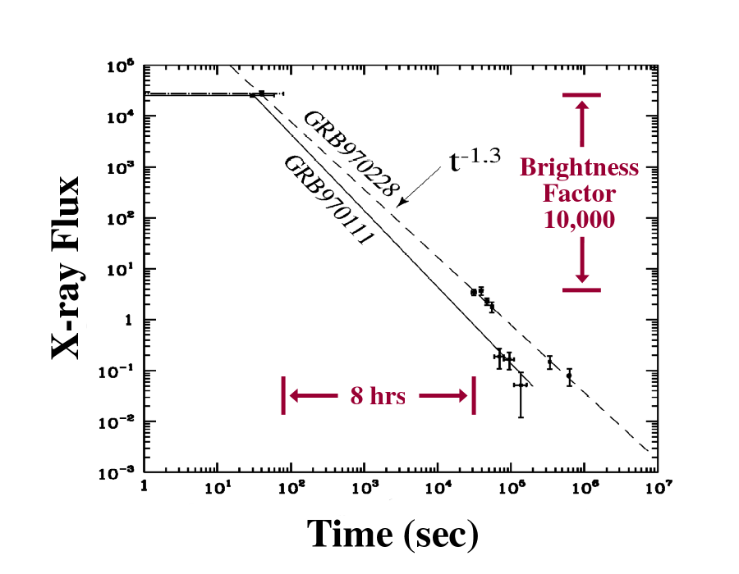
GRB Data “Gap”
Beppo-SAX took at least 6-8 hours to perform an afterglow follow-up observation with its narrow field instruments, and only saw about 10 bursts per year.

Slide 8

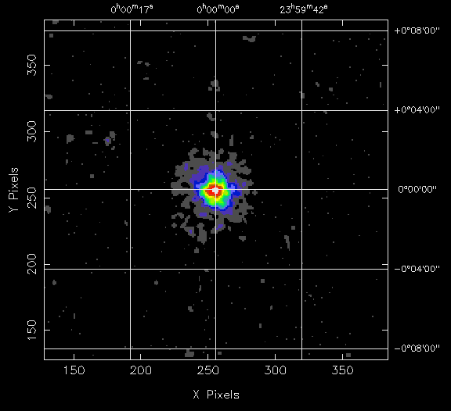
Cascade of Images from High Energy to Low
Observing Scenario:
Burst Alert Telescope triggers on GRB, calculates position on sky
Spacecraft autonomously slews to GRB position
X-ray Telescope determines more accurate position
UV/Optical Telescope images field, transmits finding chart to ground
BAT
XRT
UVOT
BAT Error
Circle
Time ~12 sec
<4 arcmin
SLEW
Time ~100 sec
~3 arcsec
Time ~250 sec
Finding Chart

Slide 9
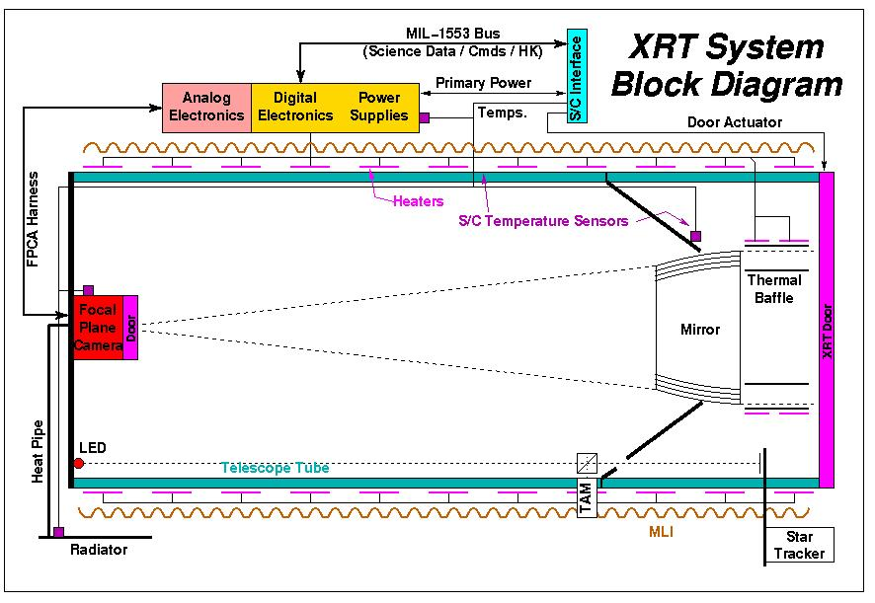
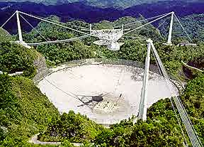
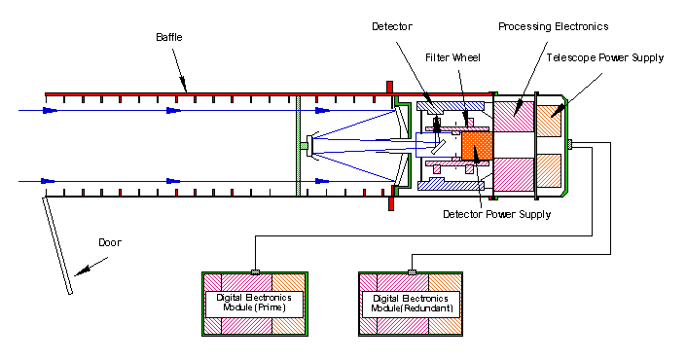
Telescope Design from High Energy to Low
Gamma Ray “Shadow”
X-ray “Grazing Incidence”
Radio
UV-Optical “Normal Incidence”

Slide 10
Atmospheric Transparency from High Energy to Low
Placeholder for slide from astronomy text.

Slide 11
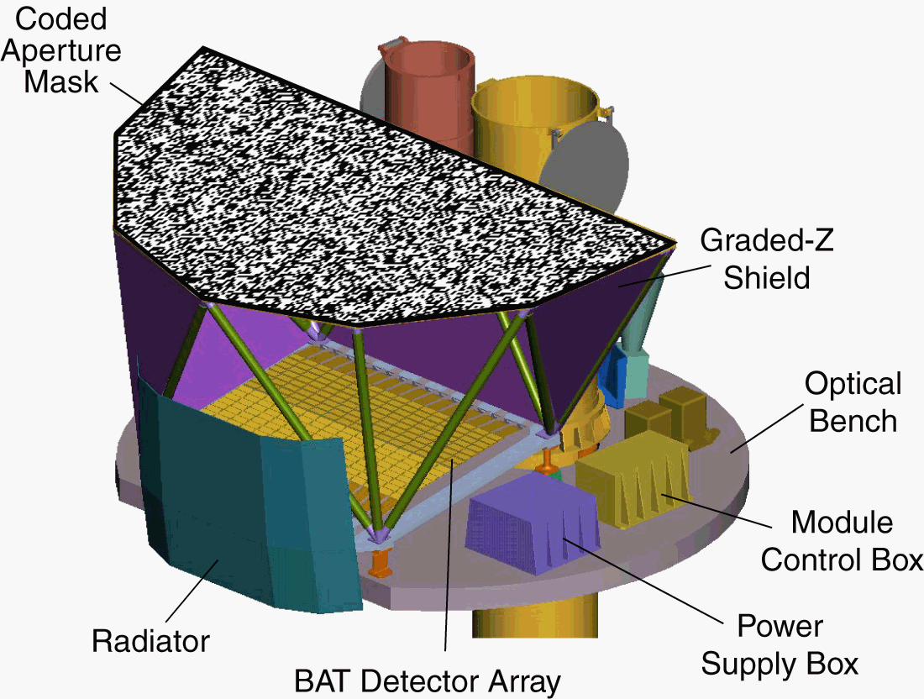
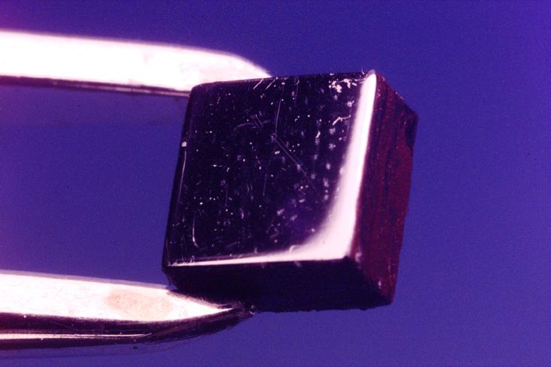
Burst Alert Telescope (BAT)
CZT Detectors
Detector Module
4 mm

Slide 12
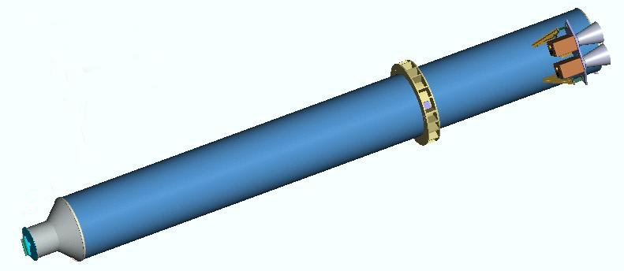
X-ray Telescope (XRT)
Forward Tube
Optical Bench Interface Flange
(OBIF)
Focal Plane Camera Assembly
(FPCA)
Star Trackers
Aft Tube
Cold Finger

Slide 13
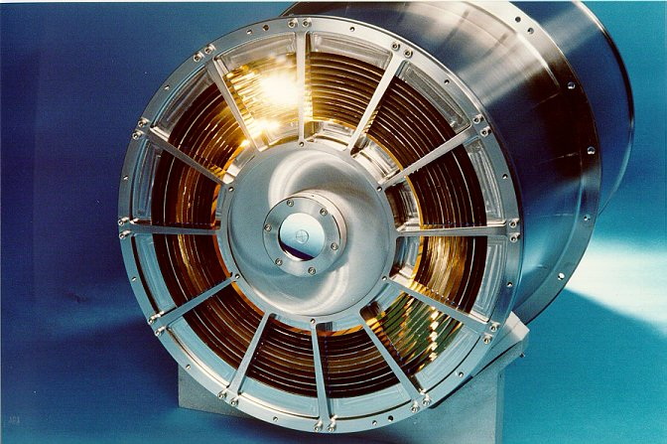
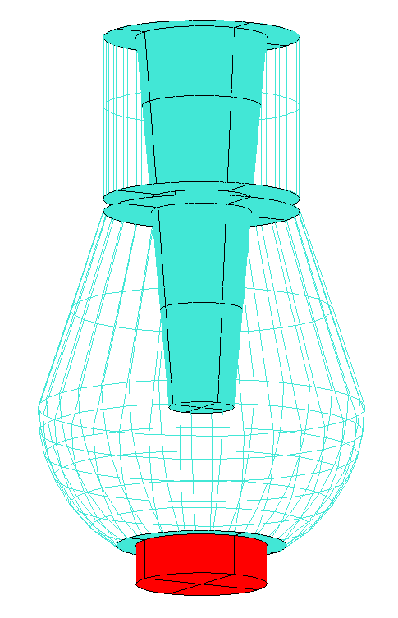
Focal Plane Camera Assembly
XRT Camera & Mirrors
Proton Shield
Wolter Type I X-ray Mirrors
TEC/Detector
Cold Finger

Slide 14
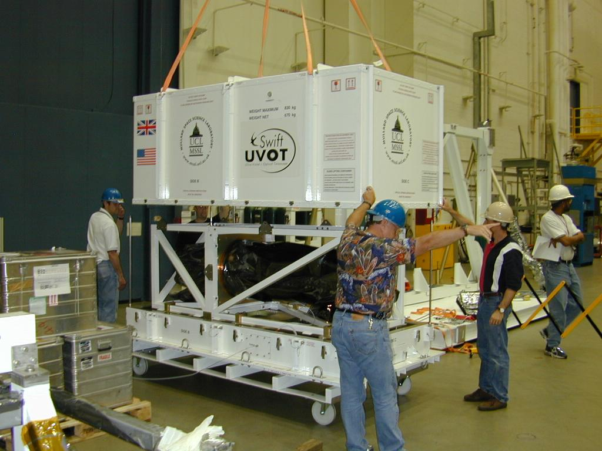
UVOT’s Arrival at GSFC – May ’02:
UV-Optical Telescope (UVOT)

Slide 15

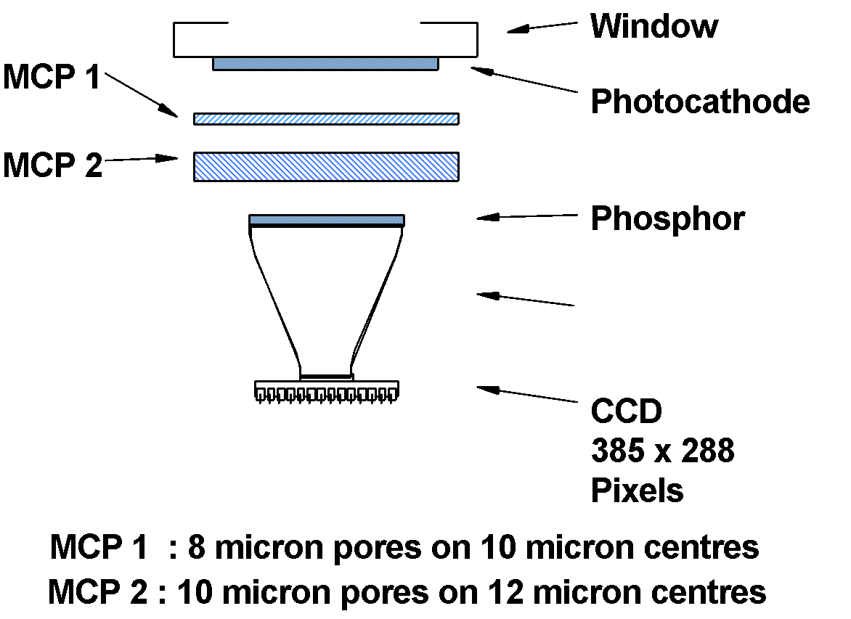
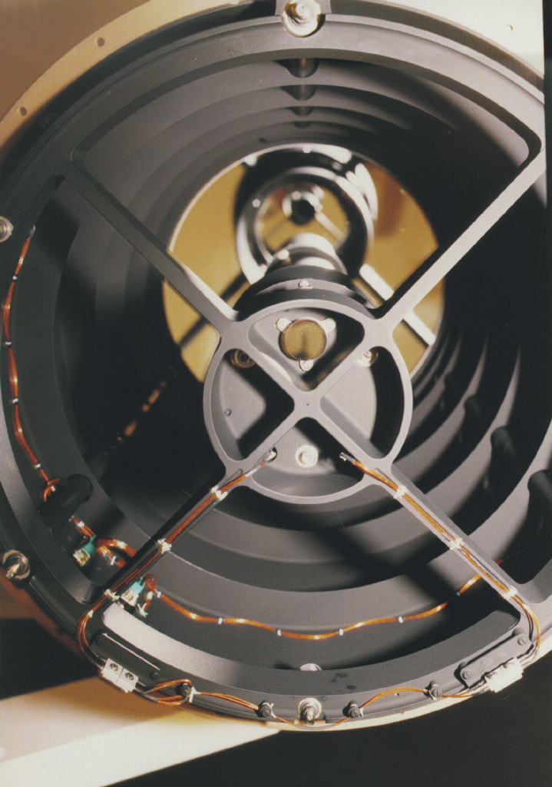

UVOT Detector & Mirrors
Ritchey-Chrétien Design
UV-Optical Mirrors
1 photon
1 photo-electron
100 electrons
1000000 electrons
100000
photons
Detector: Image Intensified CCD

Slide 16

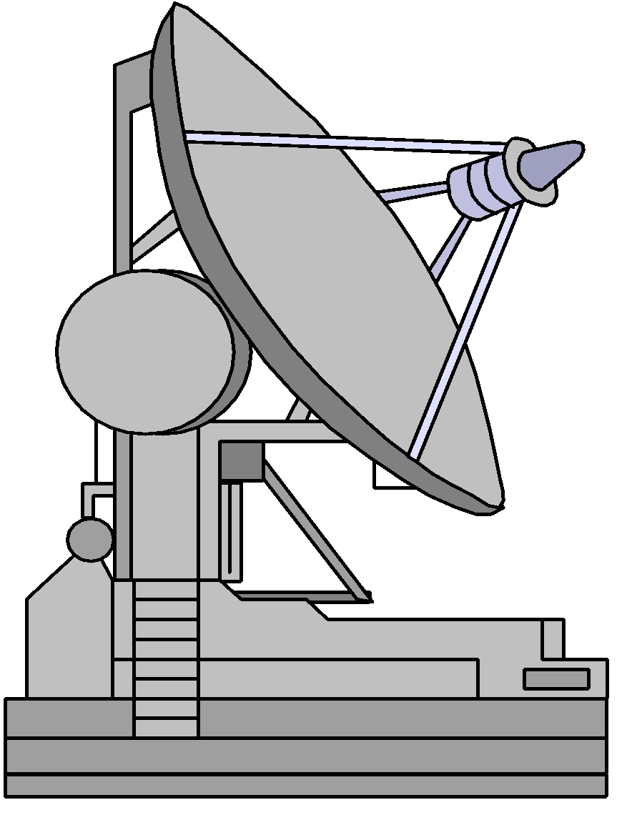
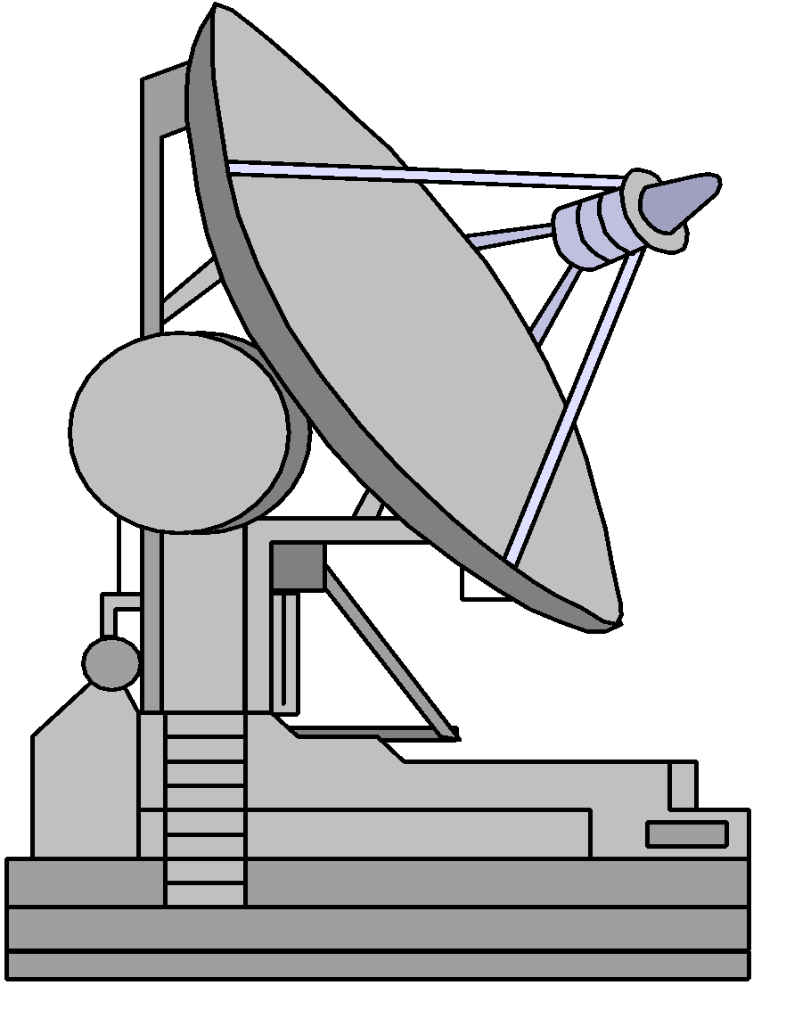
Ground System Architecture
SWIFT
S-Band CMD/TLM
1 kbps downlink (Alerts & H/K)
125 bps uplink (ToO Requests)
TDRS
S-Band CMD/TLM
2.25 Mbps downlink (RT & PB TLM)
2 kbps uplink (Normal Commanding)
Alerts,
TOO Commanding,
Contingency H/K,
Tracking
Fucino, Italy
Command, H/K, Science
Houston
ASINet
Fucino Gateway
ASINet
US Gateway
JSC
Kenya
Malindi
Ground Station
White Sands Complex (WSC)
384kbps
Leased Line
GSFC
NCC
Tracking
Data
Penn State
Mission
Operations Center
(MOC)
SN Scheduling & Status
Commands
Alerts,
H/K
To
FDF
Requests for ToOs &
Coordinated Observing
Pass-Oriented L0 Data
Orbit Data
GSFC
GSFC
GSFC
S/W Updates,
Observatory
Data
Front-End
Burst
Alerts
e.g. Chandra
Data
Analysis Tools
Swift
Science Center
Swift
Data Center
GSFC
GCN
Satellites
Flight
Dynamics
Facility
BAT
Optical
Telescopes
e.g. HET
Science
Community
HEASARC
UVOT/XRT
Tracking
Data
Quick-Look &
Production Data
(FITS)
Spacecraft
2-Line
Elements
from
WSC
Radio
Telescopes
e.g. VLA
Flight
Software
Maintenance
GSFC
NORAD
ISAC
PSU
Science
Teams
Spectrum Astro
UKDC
Observation Results
February 5, 2002 Revision J

Slide 17
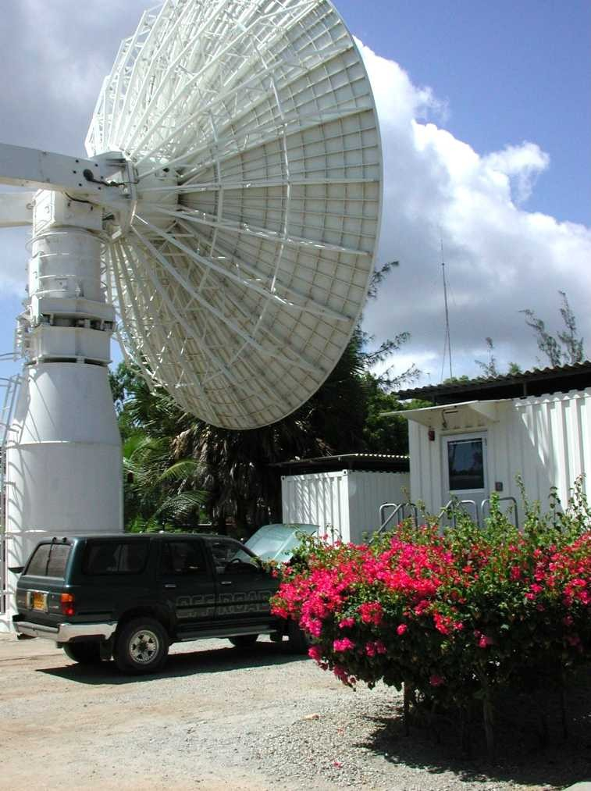
Ground Station at Malindi: Italian Space Agency & U. of Rome

Slide 18
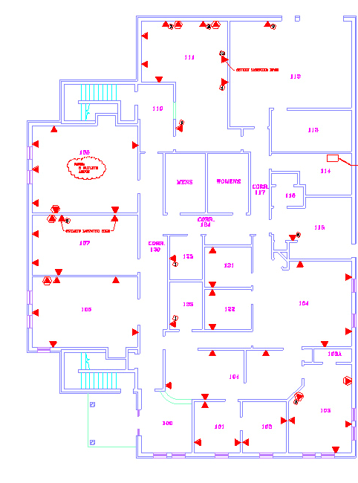
MOC Facility Layout
FOT’s Entrance
Flight Ops Control Room
L&EO Overflow
Conference Room
University Backbone
Kitchen
Scientists’ Offices
Engineers’ Offices
Visitors’ Entrance
Swift “Gallery”
Administrative Support

Slide 19
Ops Concept Refresher
Highly Autonomous Mission
On-board: Detection, Slewing, & Observations
MOC: Telemetry Monitoring, Malindi Passes, etc.
Small Operations Team At Penn State
8x5 Staffing, 24x7 Response (Paging for Bursts, Anomalies)
Omitron - Flight Ops; PSU- Science Ops (XRT, UVOT Scientists)
Sustaining Engineering by Spectrum & Instruments
Rapid & Flexible Mission Planning
Daily & Opportunistic Mission Replans
Close Coordination of Flight & Science Ops Teams
New GRB or ToO Response Options:
Typical: Add to Timeline During Scheduled Weekday Revision
Faster: Quick Replan, Upload via TDRSS or Malindi
Fastest: Upload GRB Position & Merit to FoM

Slide 20
Normal, GRB & Anomaly Operations
On-Board Automation:
Minimum 3-day Target & Command Load
Automated GRB Detection & Follow-up, S/C Checks Constraints
GRB Alerts via TDRSS to GCN & MOC
On-board Science Data Capacity ~ 4 Days
Spacecraft Capable of 72 Hour Operation Without Ground Command
Anomalies Trigger Spacecraft SOH Telemetry via TDRSS
Instruments Have Autonomous Safing and SAA Procedures
Weekday Ground Operations:
Primary Ground Station at Malindi, Kenya (Italian Space Agency)
7-8 Contacts Per Day; Most Automated
Target Timeline Revised to Accommodate New GRBs, ToOs
Updated Target & Command Load Uploaded Daily
Automated Monitoring of Spacecraft & Instruments State of Health
Off-shift (Nights & Weekends):
Paging for GRBs, Time-critical ToOs, & Anomalies
Remote Display of Alerts, Quicklook, SOH
If Commanding Warranted, Travel to MOC

Slide 21
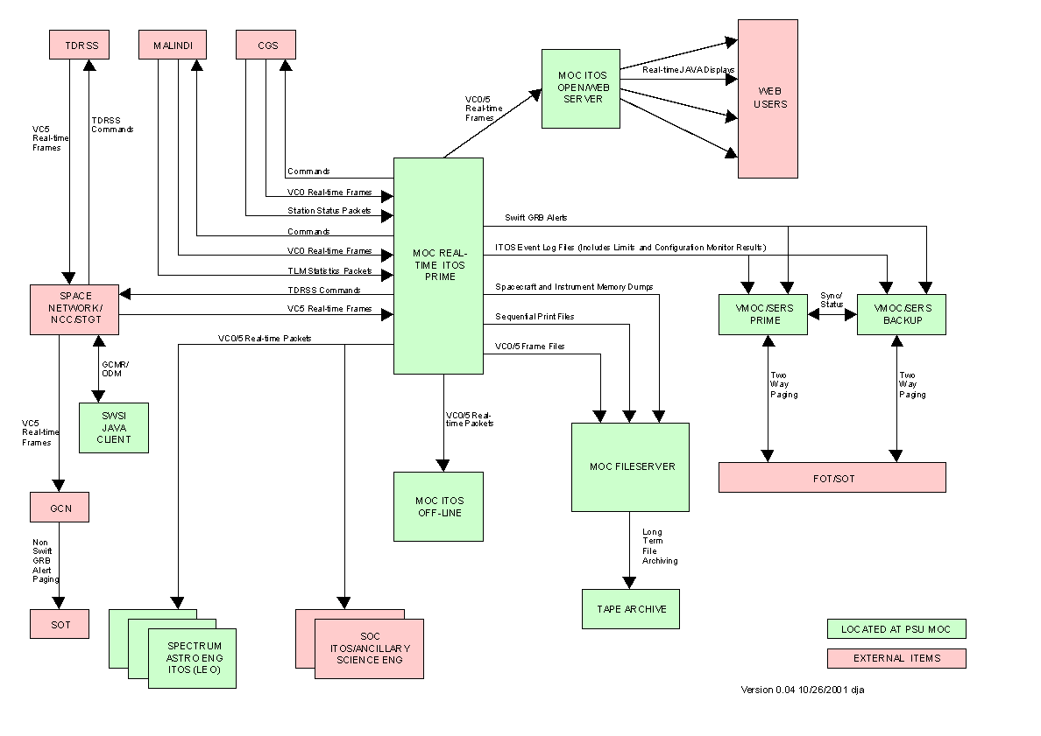
MOC Operational Dataflows: R/T

Slide 22

Remote Access

Slide 23
Mission Science Planning
Typical Science Timeline Inputs
New GRB Afterglows: ~1 New Afterglow Per Day
Time-critical ToO: 1 Per Week to Followup
Previous GRB Afterglows: 3-4 Visible (at High Energies)
Planned ToOs (Monitoring, etc.): ~1 Per Week
BAT Transient Monitoring: (Rate?)
BAT Survey Coverage: 12 of 15 Pointings Per Day (80%)
Calibrations Using Astrophysical Sources: ~1 Per Week
Major Planning Considerations
4-5 Targets Per Orbit
Multi-orbit Observation Times Require “Juggling” of Targets
Choose BAT Survey Pointings & Safe Pointings (not safehold) To Be Astrophysically Interesting (Vote Now For Your Favorite)
Notes:
2

Slide 24
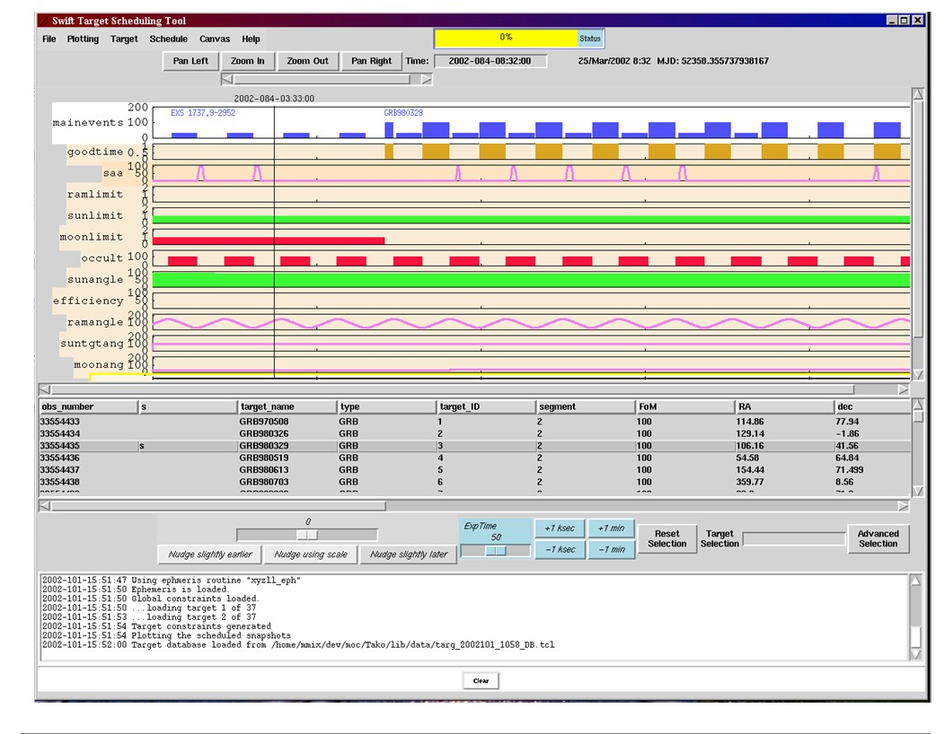
TAKO Target Scheduler

Slide 25


The Swift Gamma Ray Burst Explorer: Catching Gamma Ray Bursts on the Fly
“Flight very rapid, ‘twinkling’, sailing between spurts.”
– Roger Tory Peterson
“Swifts fly expertly on their first try. Regardless of their introduction to flight, all young are adept at it soon after they take their initial leap.”
– National Geographic Society

